Slide 1
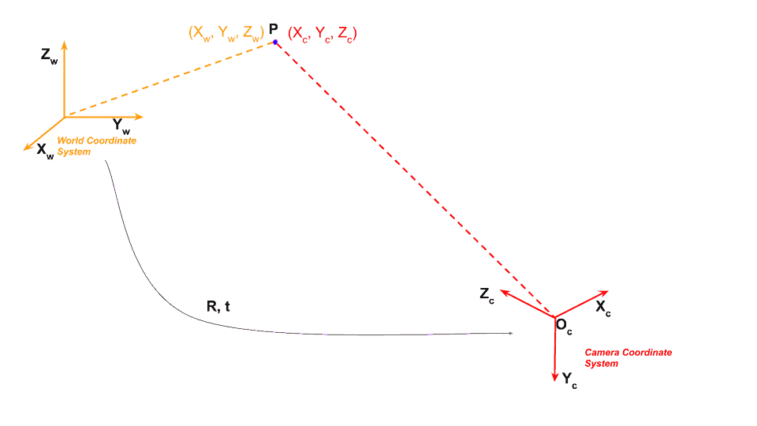
(오른손 좌표계)

Slide 2
BEV 이미지 크기 및 픽셀 별 거리 정보 설계
World (X, Y, Z) : (50, 10, 0)
Width : 800 px
World (X, Y, Z) : (50, -10, 0)
BEV (u, v) : (0, 0)
BEV (u, v) : (799, 0)
…
Height : 860 px
…
…
…
World (X, Y, Z) : (7 + 0.05, 10 , 0)
…
BEV (u, v) : (799, 859 - 1)
World (X, Y, Z) : (7, 10, 0)
World (X, Y, Z) : (7, -10, 0)
BEV (u, v) : (0, 859)
BEV (u, v) : (799, 859)
X
World (X, Y, Z) : (7, -10 + 0.025, 0)
Y
Z
BEV (u, v) : (799 -1, 859)

Slide 3
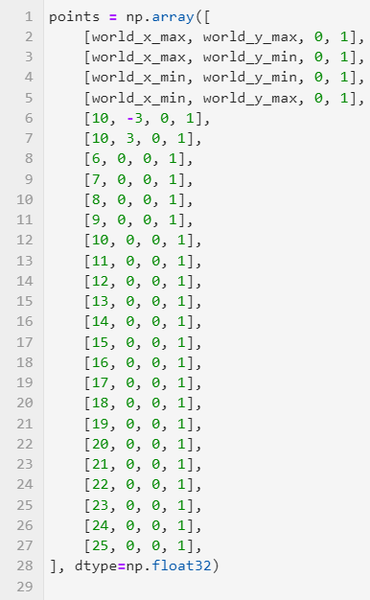
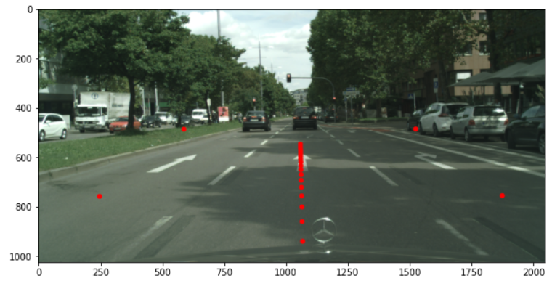

Slide 4
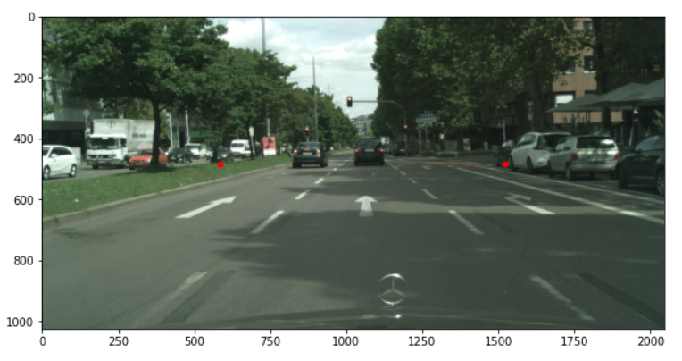
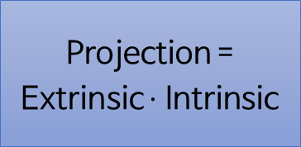
World (X, Y, Z) : (50, 10, 0)
World (X, Y, Z) : (50, -10, 0)
Z
X
BEV (u, v) : (0, 0)
BEV (u, v) : (799, 0)
Y
…
Projection =
Extrinsic $⋅$ Intrinsic
…
…
…
…
X
Y
Z

Slide 6
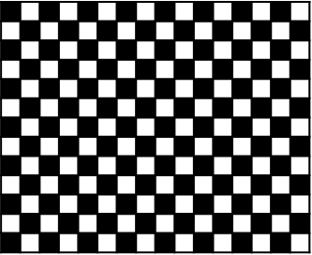
0.05
0.05
X
Z
Y
원점
0.09
front
left
right
rear
0.19
0.195
0.105
0.51
0.51
0.51

Slide 7
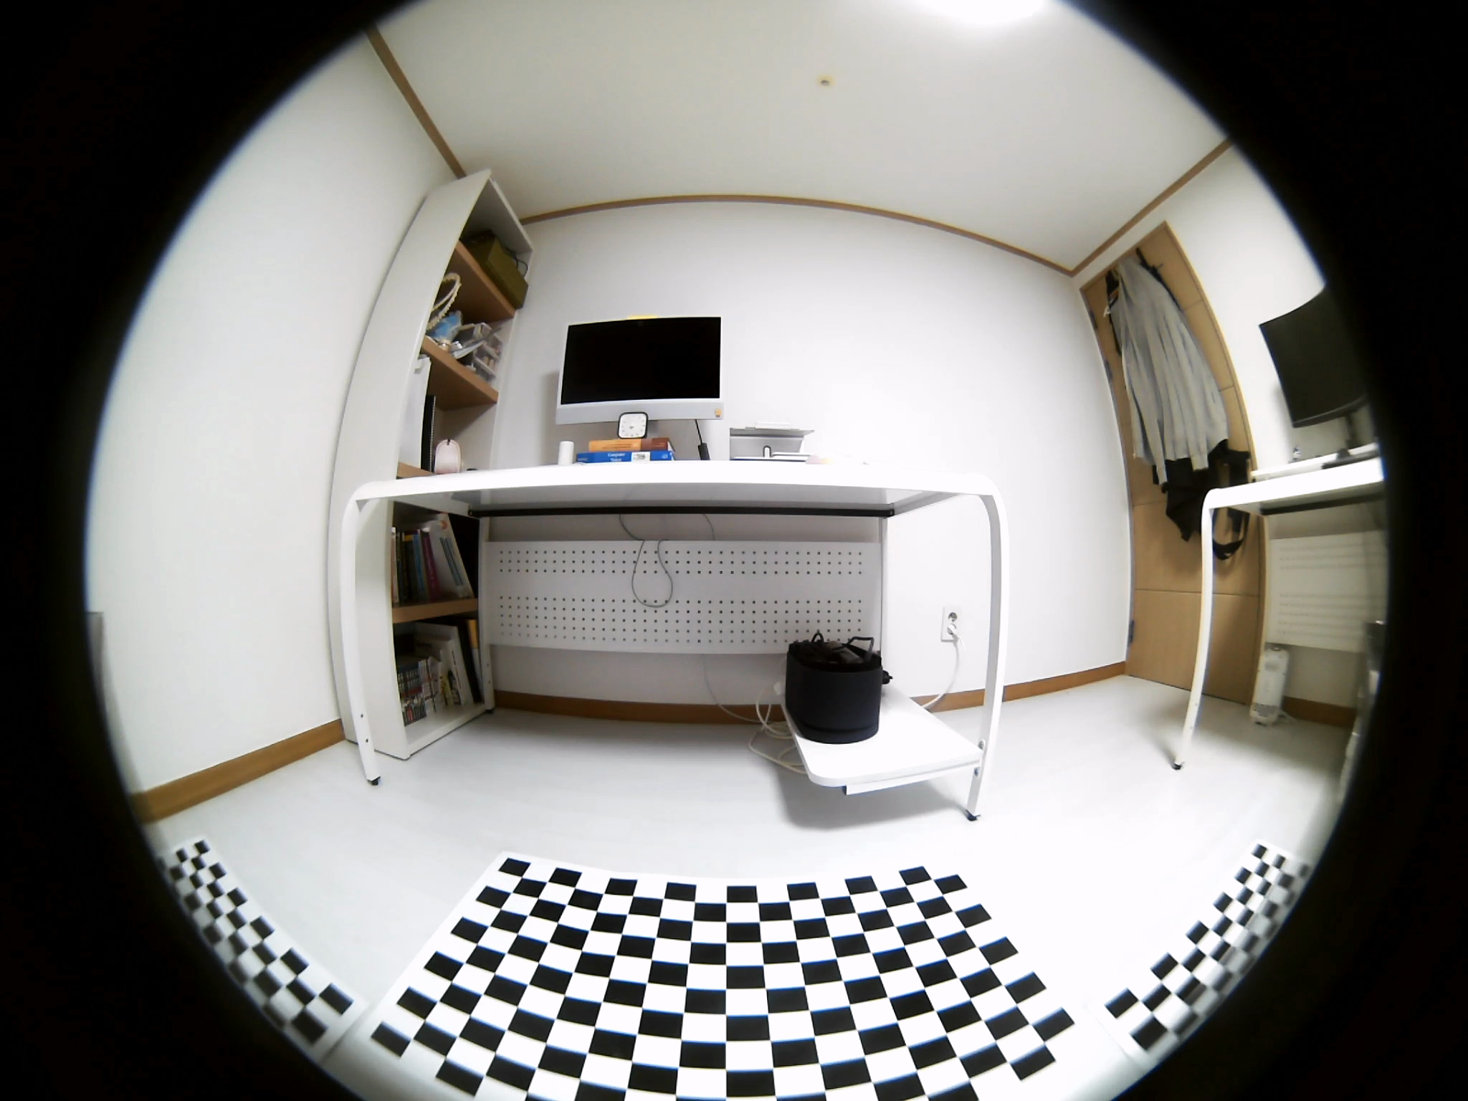
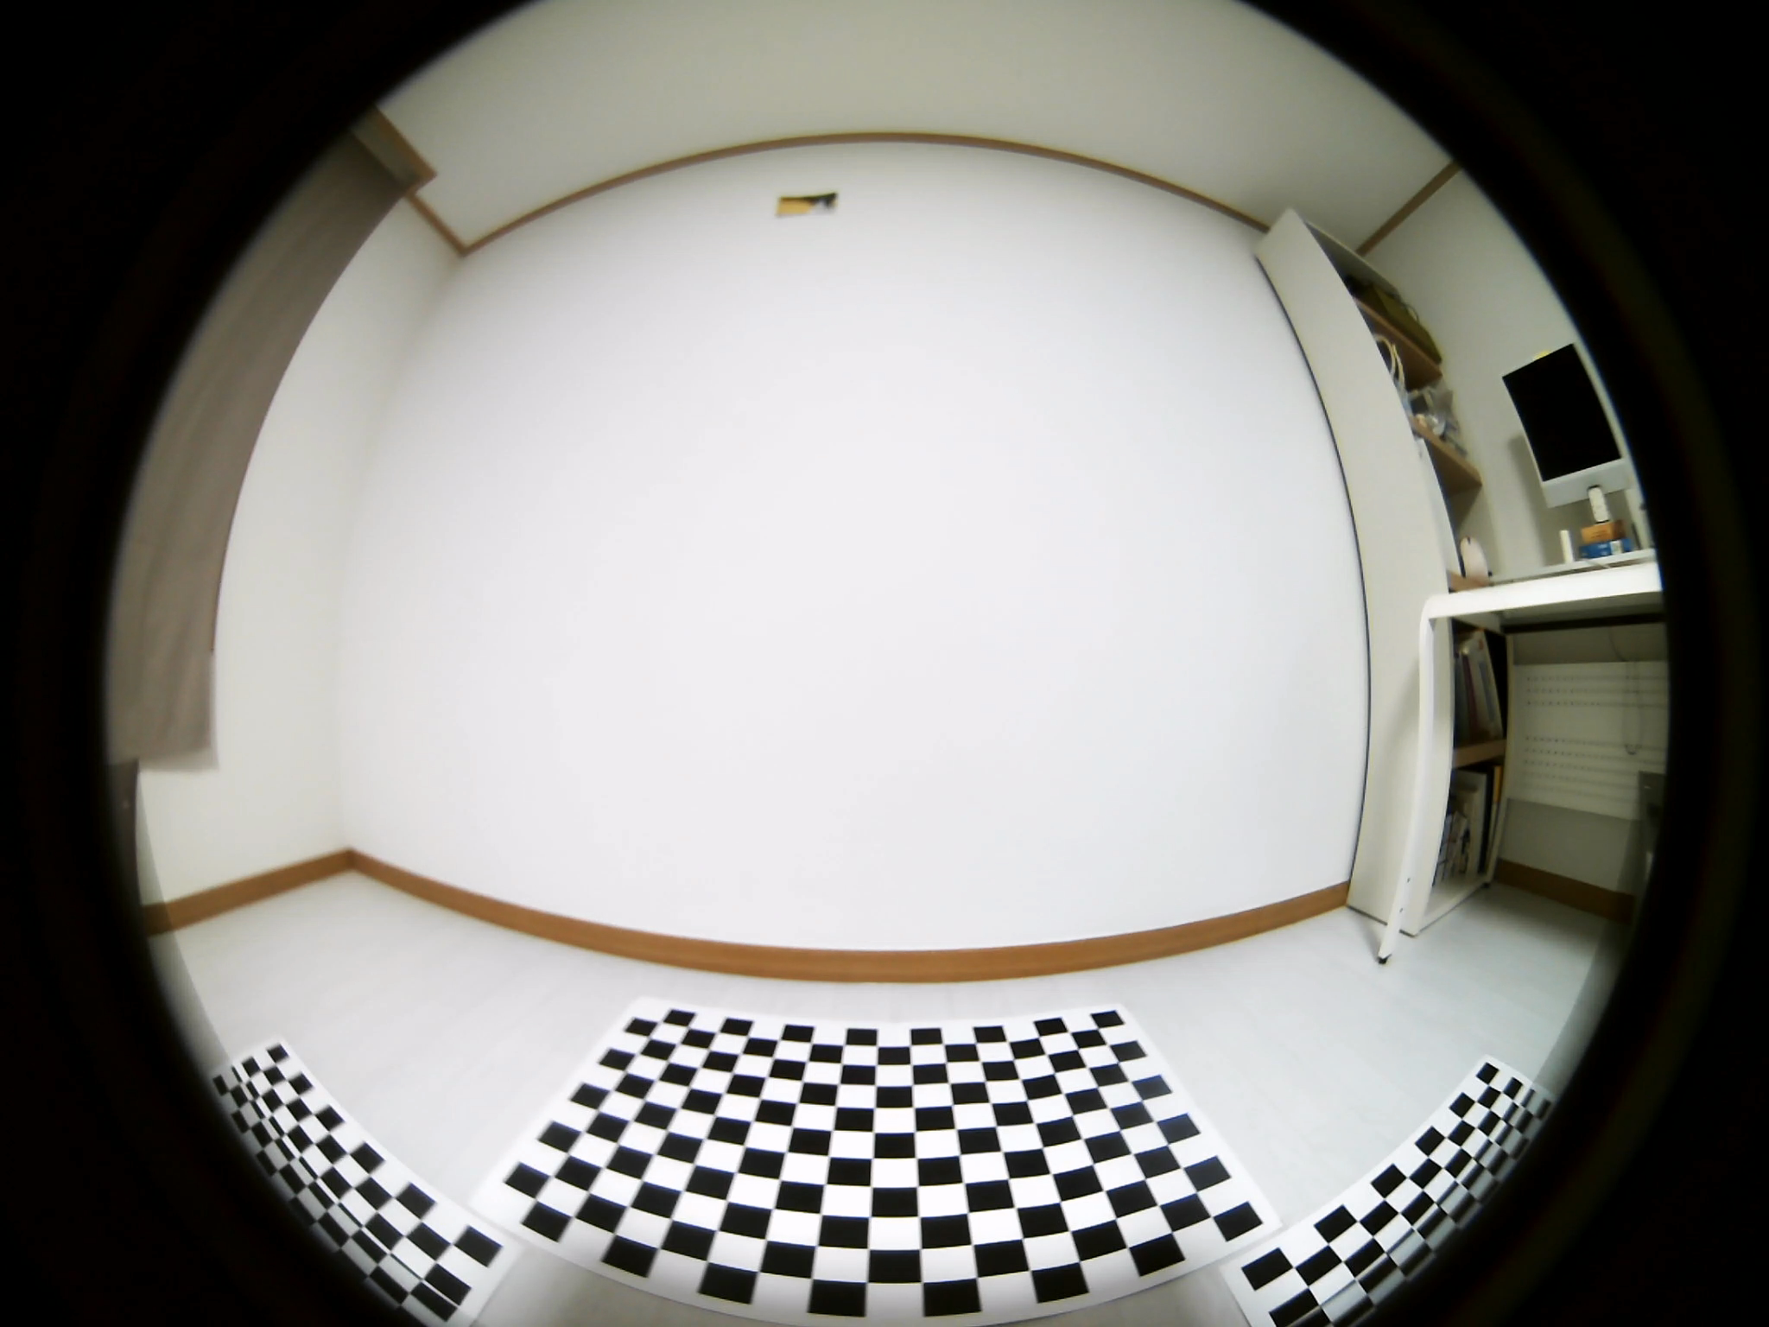
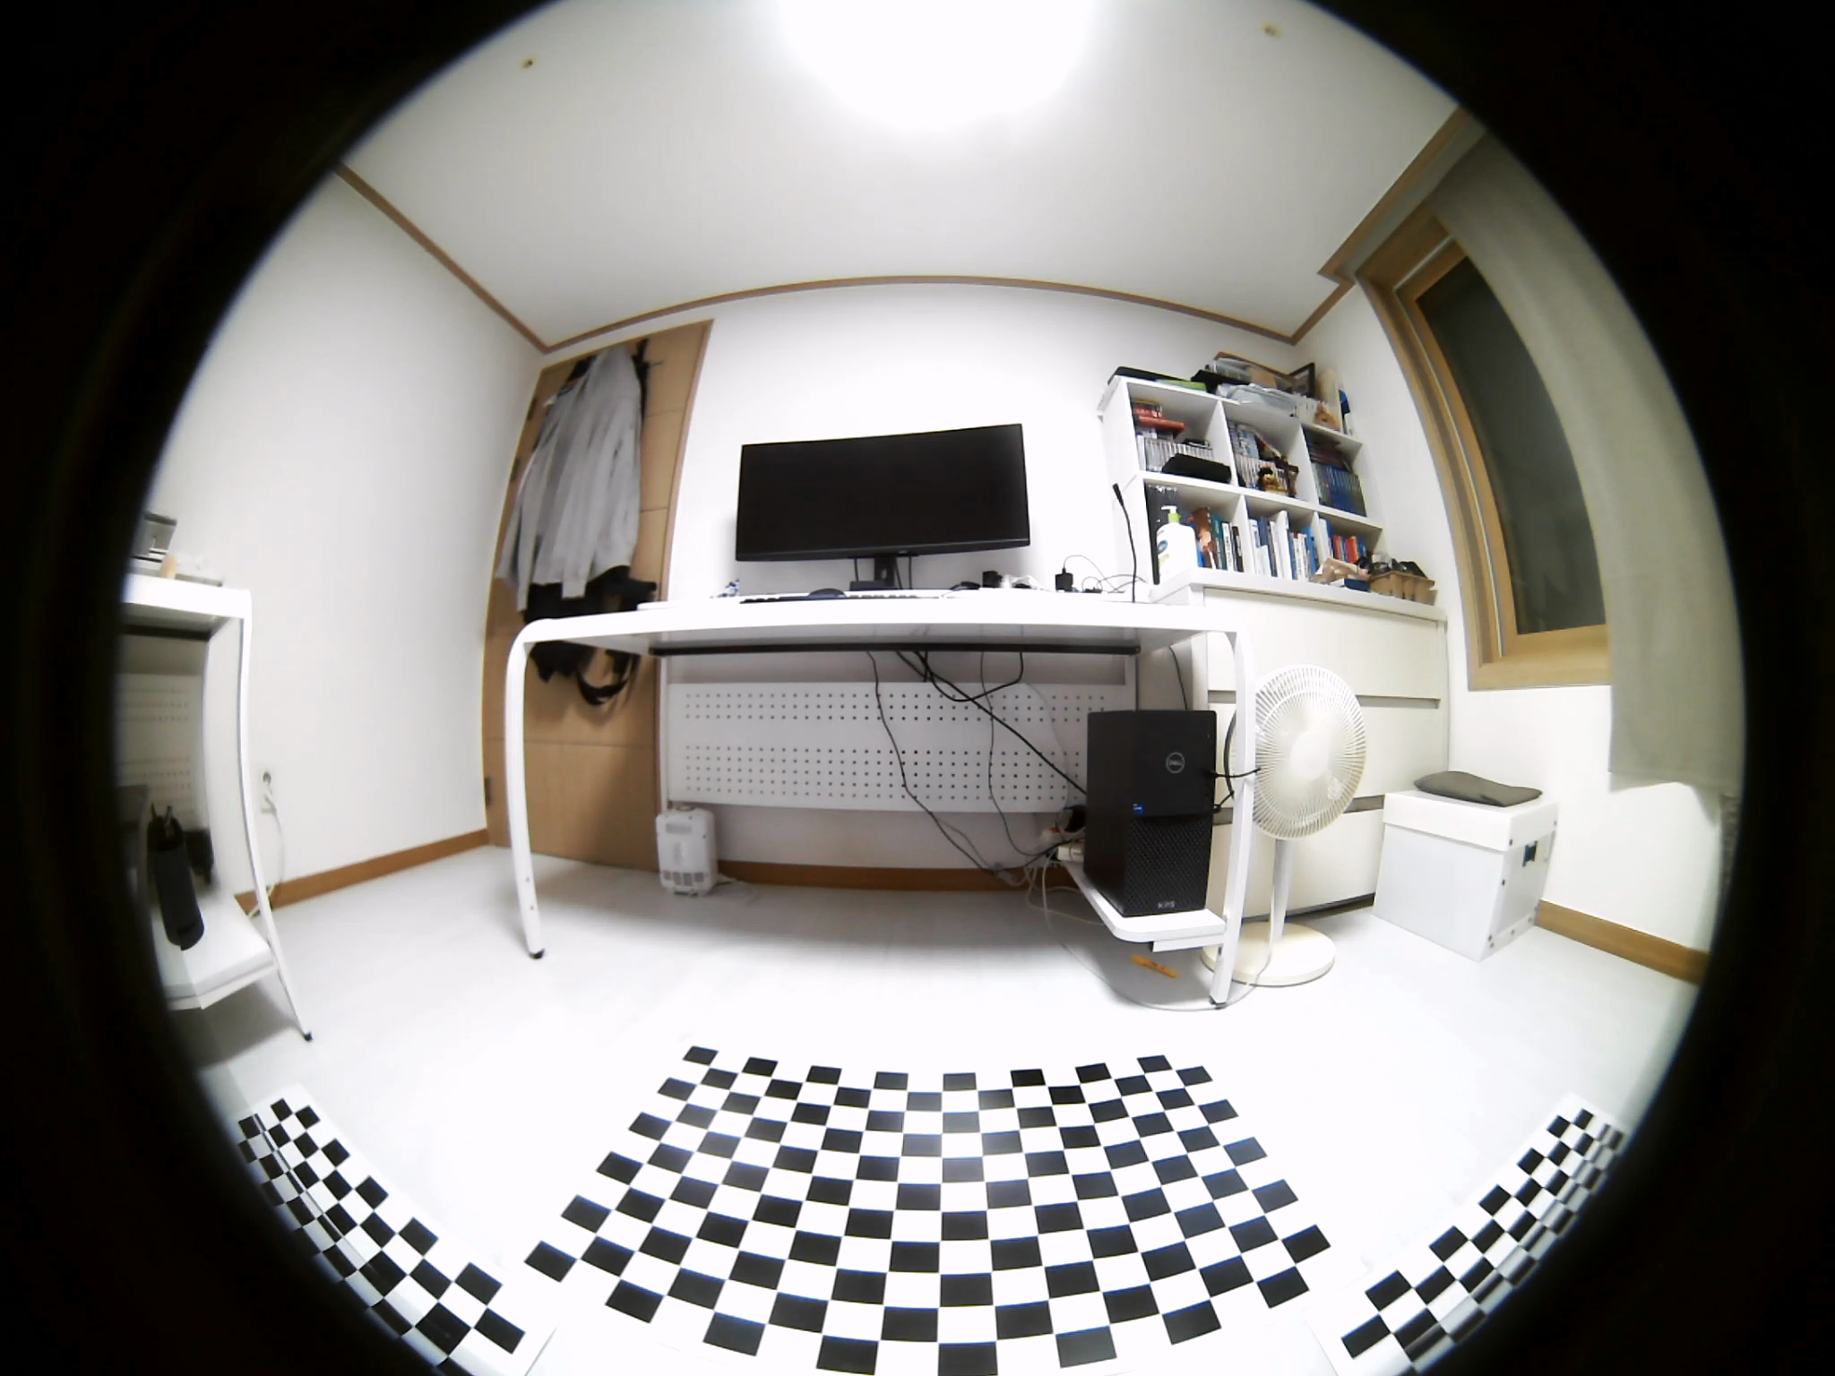
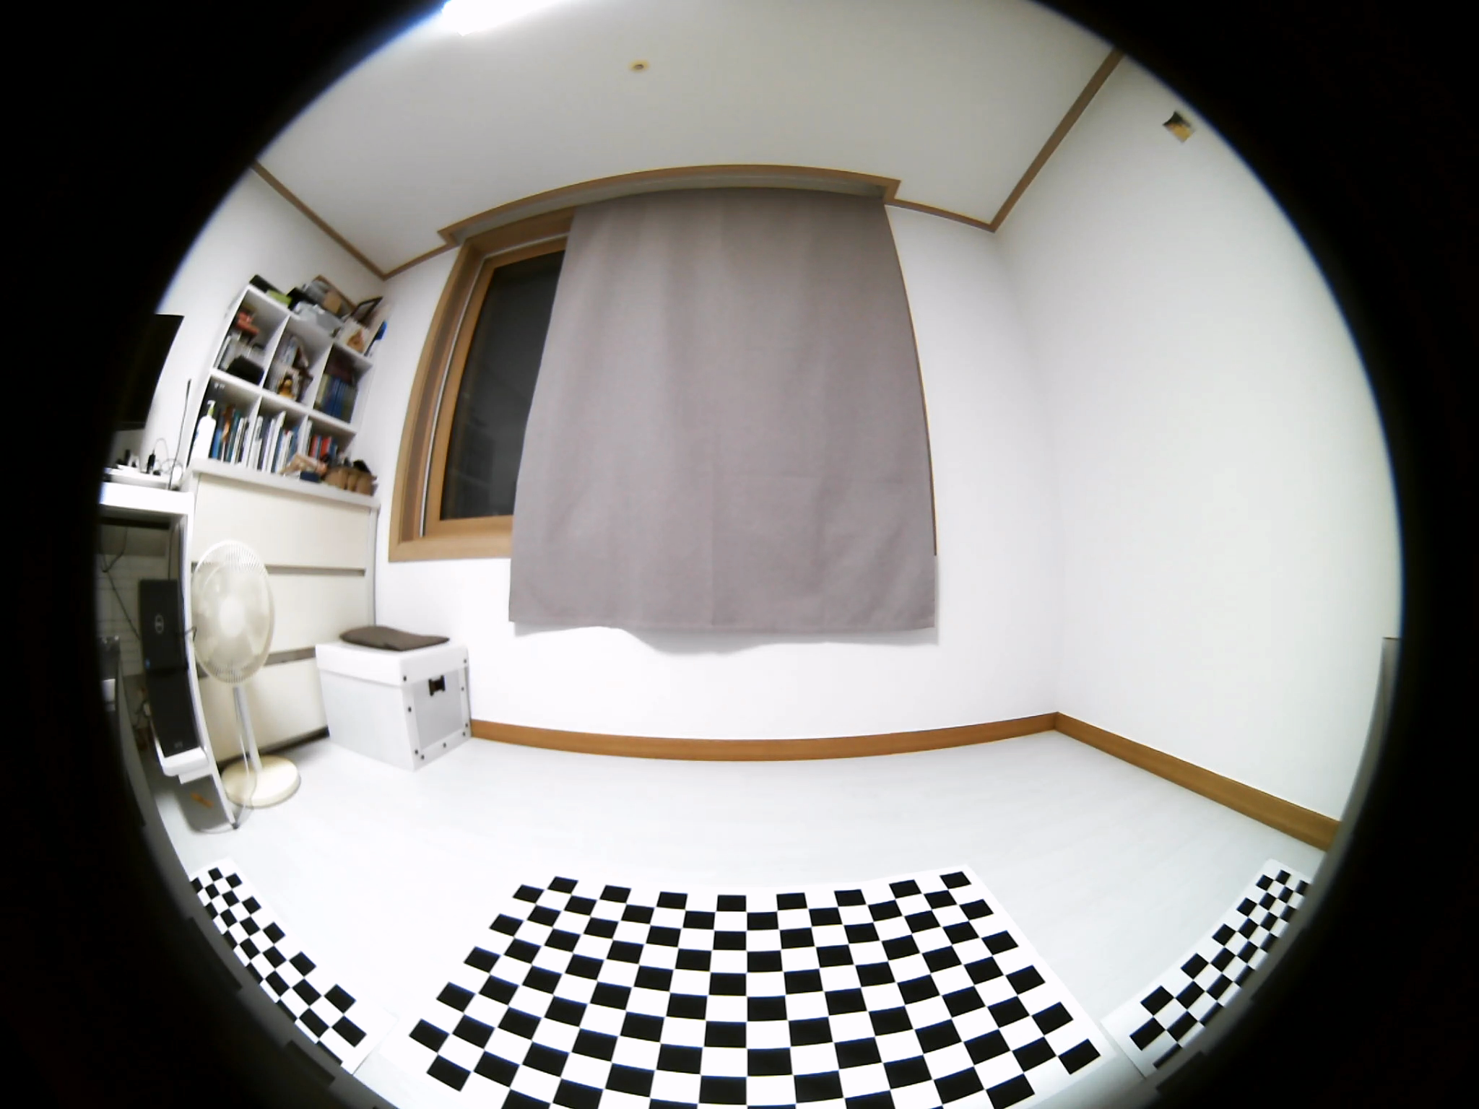
front_fisheye_camera
left_fisheye_camera
right_fisheye_camera
rear_fisheye_camera

Slide 8
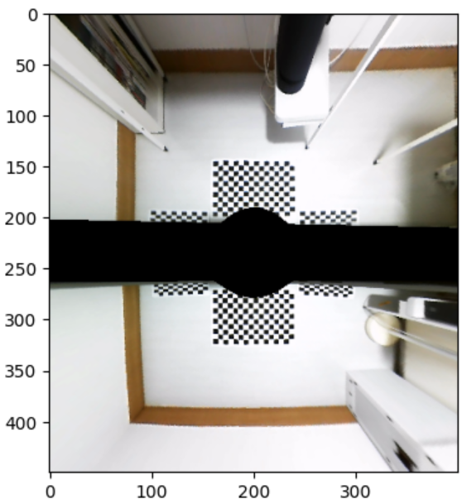
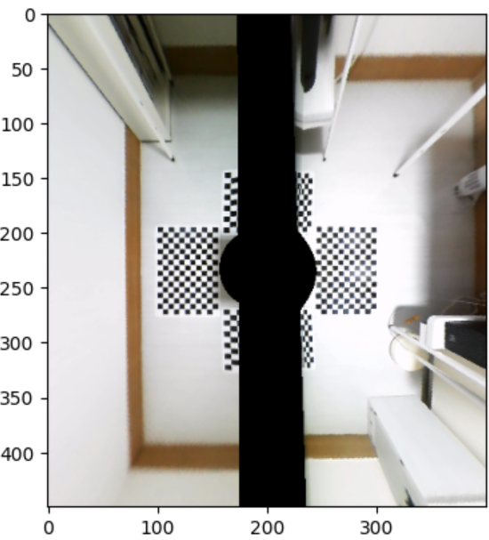
front_fisheye_camera + rear_fisheye_camera
left_fisheye_camera + right_fisheye_camera

Slide 9
